Slide 1
File System: A file system is a process that manages how and where data on a storage disk, typically a hard disk drive (HDD), is stored, accessed and managed.
File:
A file is an object on a computer that stores data, information, settings, or commands used with a computer program.
Directory:
A directory is a location for storing files on your computer. Directories are found in a hierarchical file system, such as Linux, MS-DOS, OS/2, and Unix.

Slide 2
FILE ATTRIBUTES:
ARCHIVE BIT:
For backups that use archive bits, this bit is turned off after the backup completes, indicating to the system that the file has been backed up.
HIDDEN BIT:
The purpose of the hidden bit is to make the file invisible in certain applications file list display.
COMPRESSION:
Windows supports compression on individual files, folders, and entire NTFS volumes. Only NTFS can read the compressed form of the data.
ENCRYPTING FILE SYSTEM:
Windows uses Encrypting file system to store data in encrypted form, which provide security when the storage media are removed from a system.

Slide 3
TYPES OF FILE SYSTEMS
FAT (FILE ALLOCATION TABLE)
NTFS (NEW TECHNOLOGY FILE SYSTEM)

Slide 4
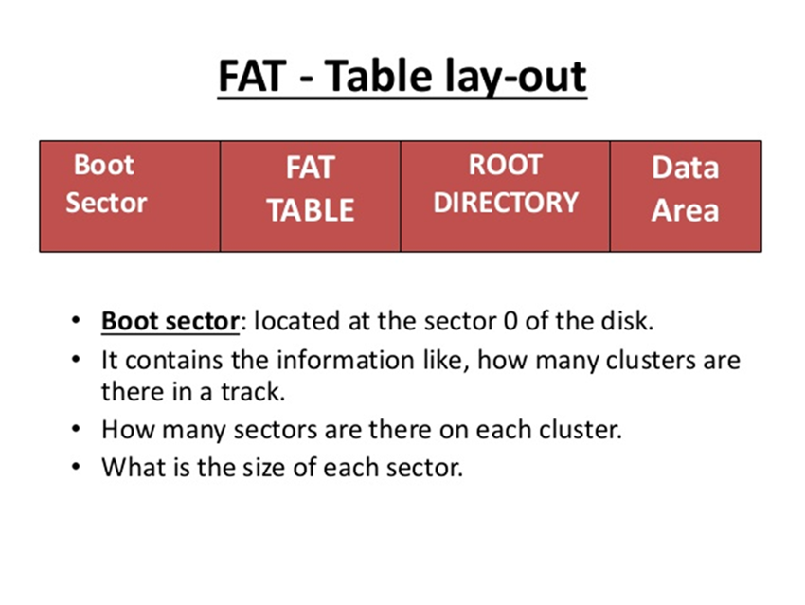
FAT (FILE ALLOCATION TABLE)
The fat region contains two copies of the file allocation table for the sake of redundancy checking.
Fat region contains maps of data region, indicating which clusters are used by files and directories.
Root directory is a Directory Table that stores information about the files and directories located in the root directory.
Data area is where the actual file and directory data is stored and takes up most of the partition.

Slide 5
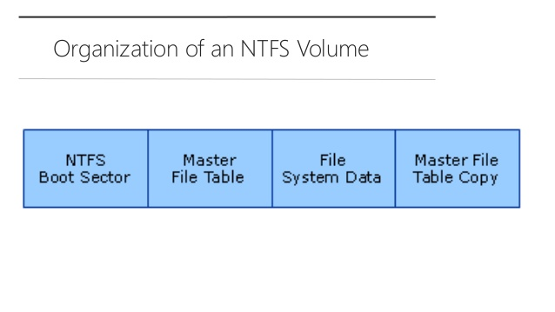
NTFS (NEW TECHNOLOGY FILE SYSTEM)
NTFS boot sector contains the BIOS parameter block that stores the information about the layout of the volume and the file system structures.
Contains the information necessary to retrieve files from the NTFS partition, such as the attributes of a file.
Stores data that is not contained within the Master File Table.
Includes copies of the records essential for the recovery of the file system if there is a problem with the original copy.

Slide 6
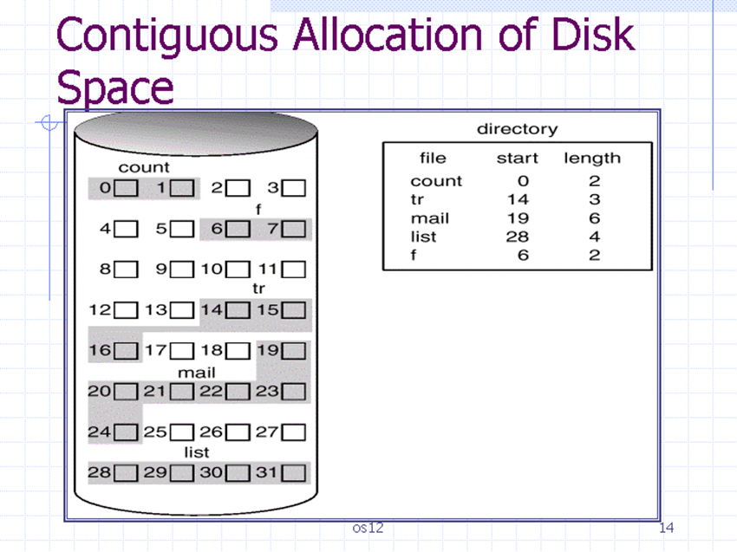
ALLOCATION METHODS:
CONTIGUOUS ALLOCATION
Each file occupies a set of contiguous blocks on the disk.
If only one job is accessing the disk, accessing block b+1 after block b requires no head movement.
Simple only starting location and length are required.
Sequential and direct access.

Slide 7
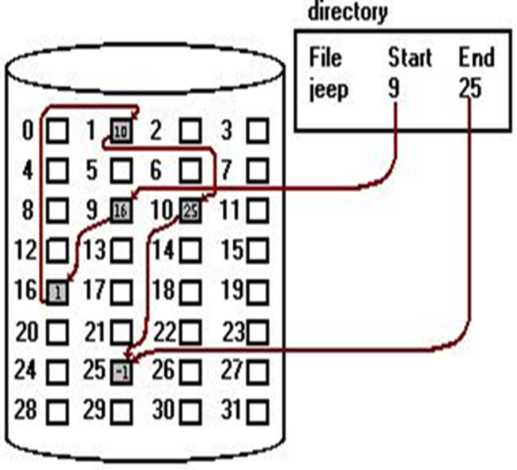
LINKED ALLOCATION
Each file is a linked list of disk blocks. Blocks may be scattered anywhere on the disk
Directory entry has a pointer to the first and the last blocks of the file.

Slide 8
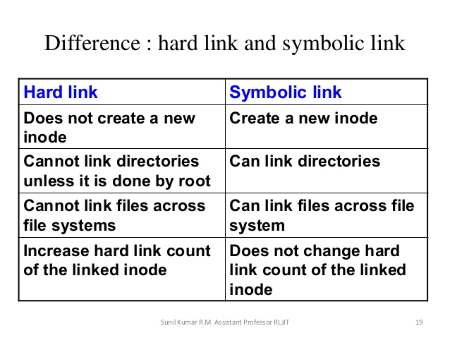
LINKS IN NTFS

Slide 9
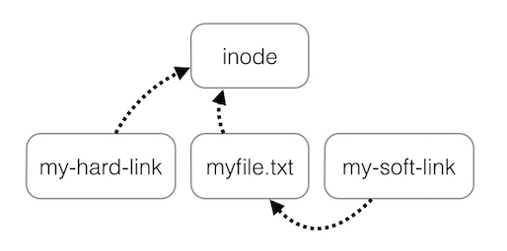
LINKS IN NTFS:

